Slide 1
AtliQ Hardware
Ad-hoc Analysis
Business Intelligence Team

Slide 2

Introduction
AtliQ Hardware (imaginary company) is one of the leading computer hardware producers in India and well expanded in other countries too.
However, the management noticed that they do not get enough insights to make quick and smart data-informed decisions.

Slide 3
Tasks
There are 10 ad-hoc requests for which the business needs insights.
Run an SQL query to answer these requests.
Add some visuals to support your findings.

Slide 4
Tools Used for Analysis
Power BI
MS Excel
MySQL
Used to create Visuals
Used to streamline data and create Visuals
Used for creating database queries

Slide 5
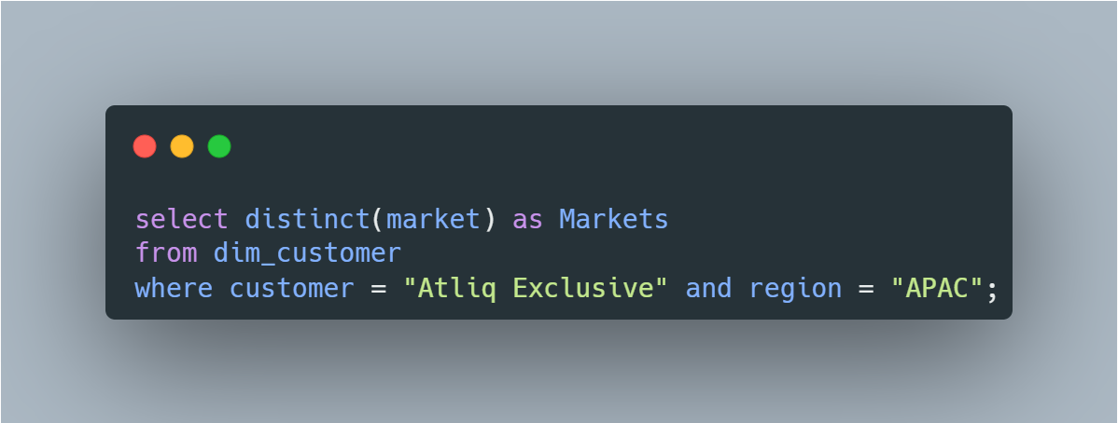
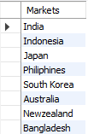
1. Provide the list of markets in which customer "Atliq Exclusive" operates its business in the APAC region.
SQL Query and Results

Slide 6
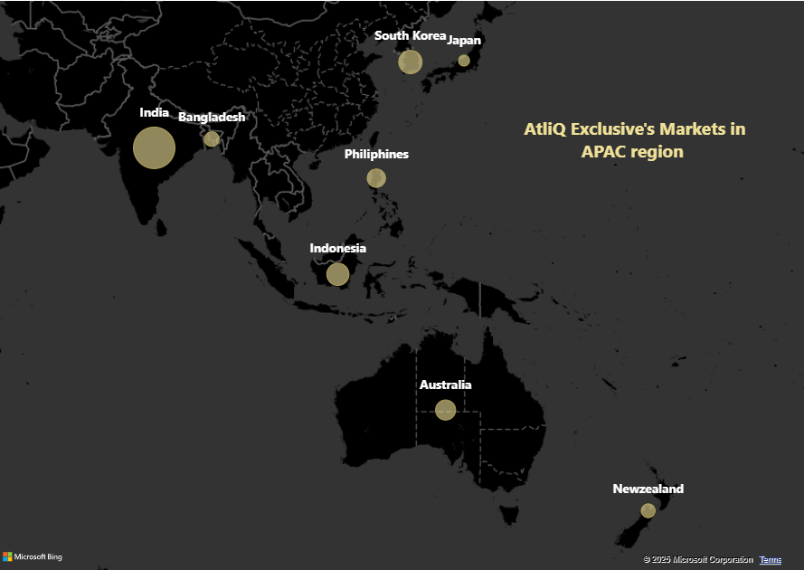
Visual Representation of first request

Slide 7
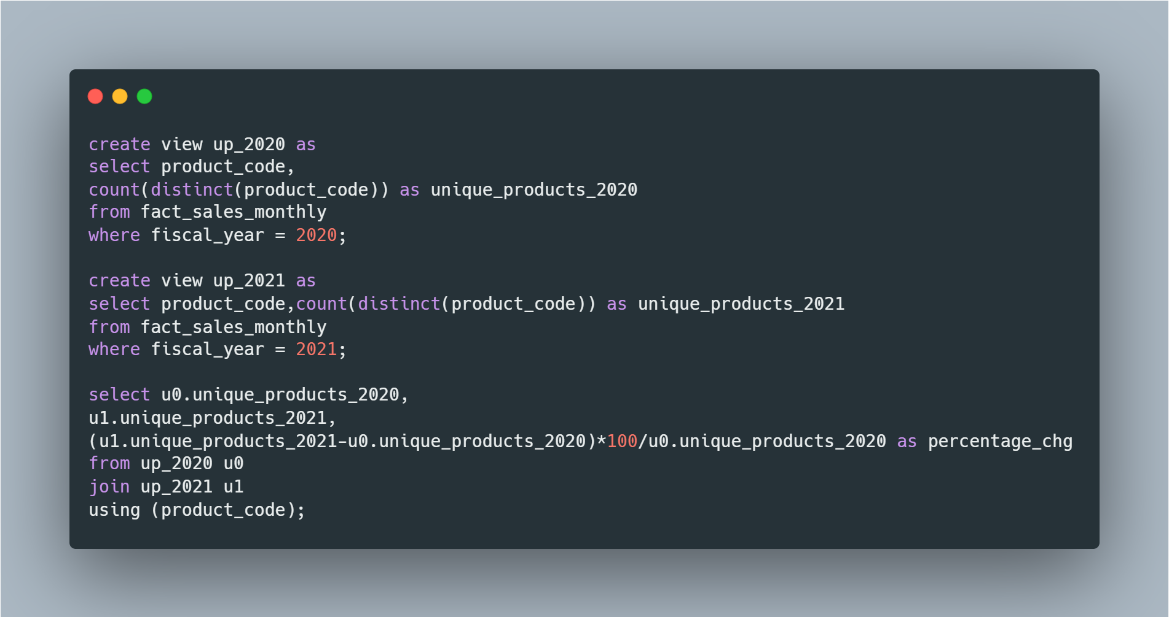

2. What is the percentage of unique product increase in 2021 vs. 2020?
SQL Query and Results

Slide 8
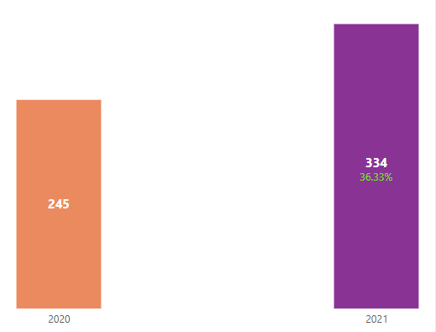
Visual Representation of second request

Slide 9
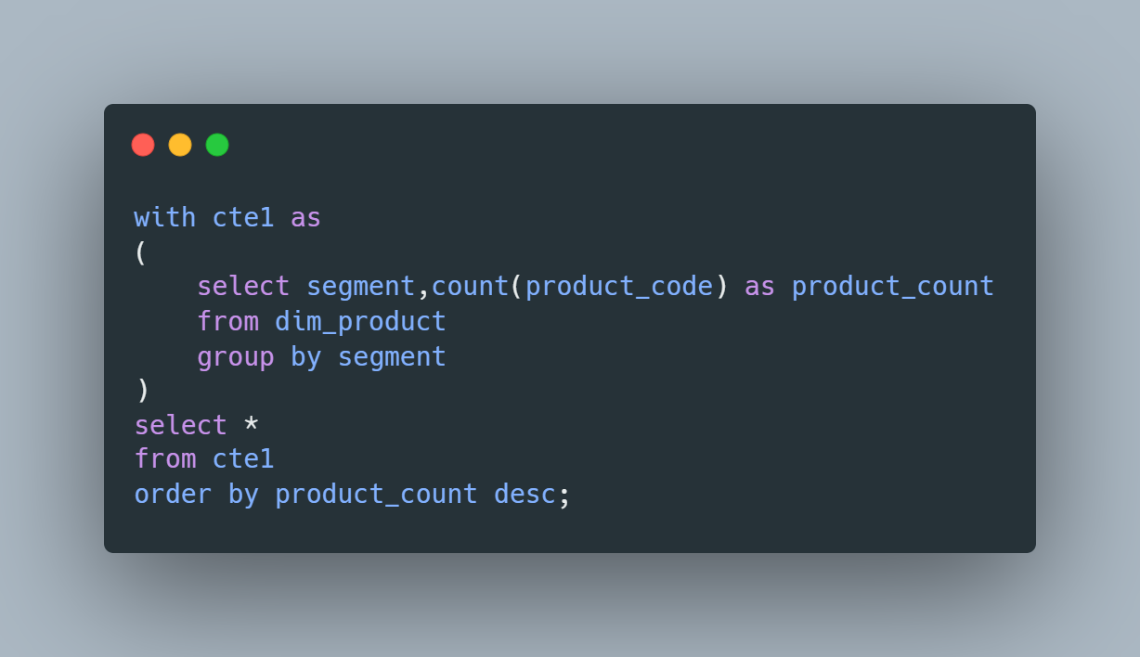
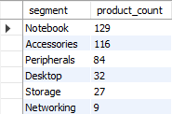
3. Provide a report with all the unique product counts for each segment and sort them in descending order of product counts.
SQL Query and Results

Slide 10
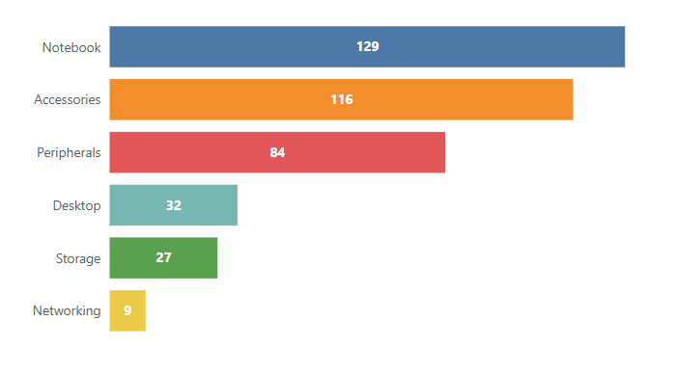
Visual Representation of third request

Slide 11
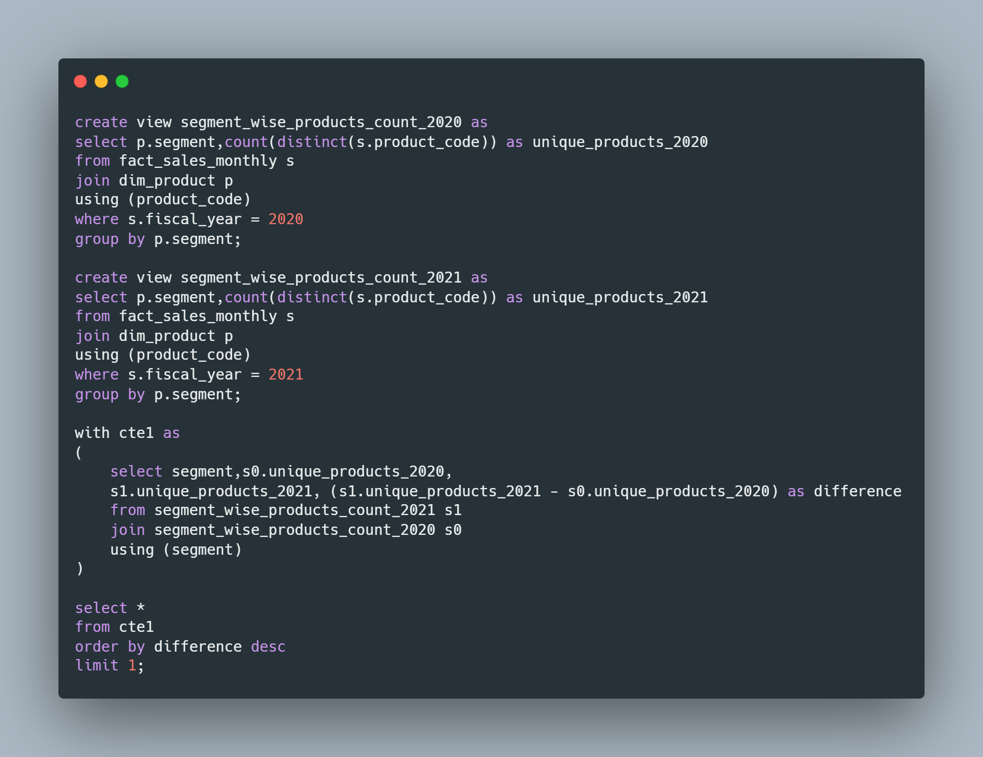
4. Follow-up: Which segment had the most increase in unique products in 2021 vs 2020?
SQL Query and Results

Slide 12
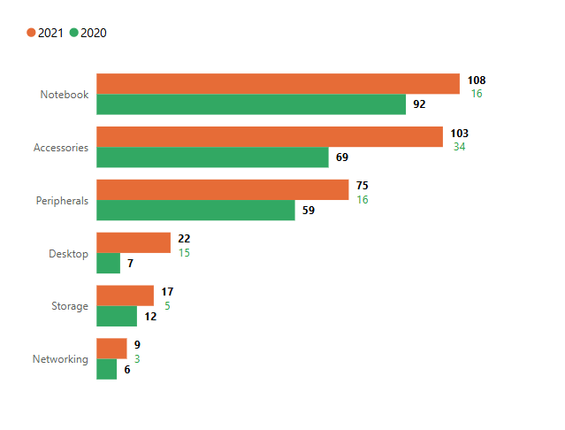
Visual Representation of fourth request

Slide 13
Additional Insights from previous visual
As we can see from the visual in the previous slide, the segment with maximum increase in unique products is Accessories with an additional 34 unique products in 2021.

Slide 14
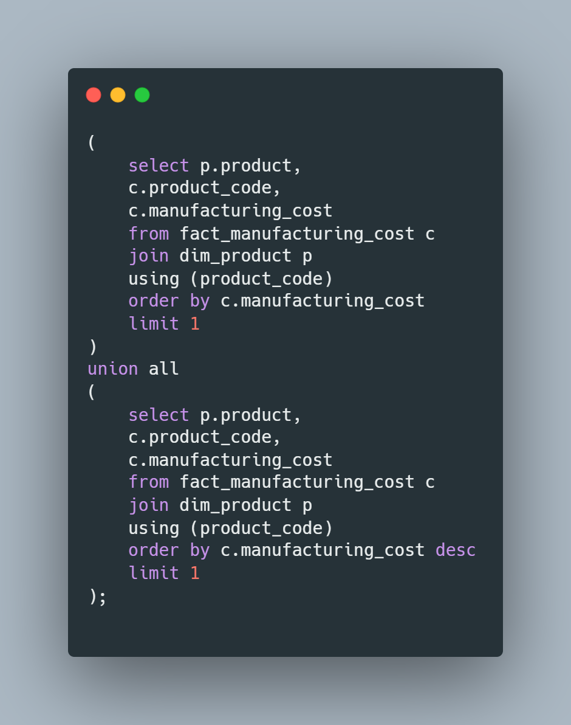

5. Get the products that have the highest and lowest manufacturing costs.
SQL Query and Results

Slide 15
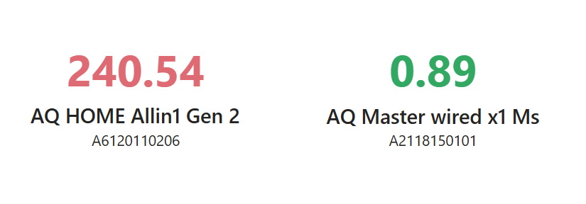
Visual Representation of fifth request

Slide 16
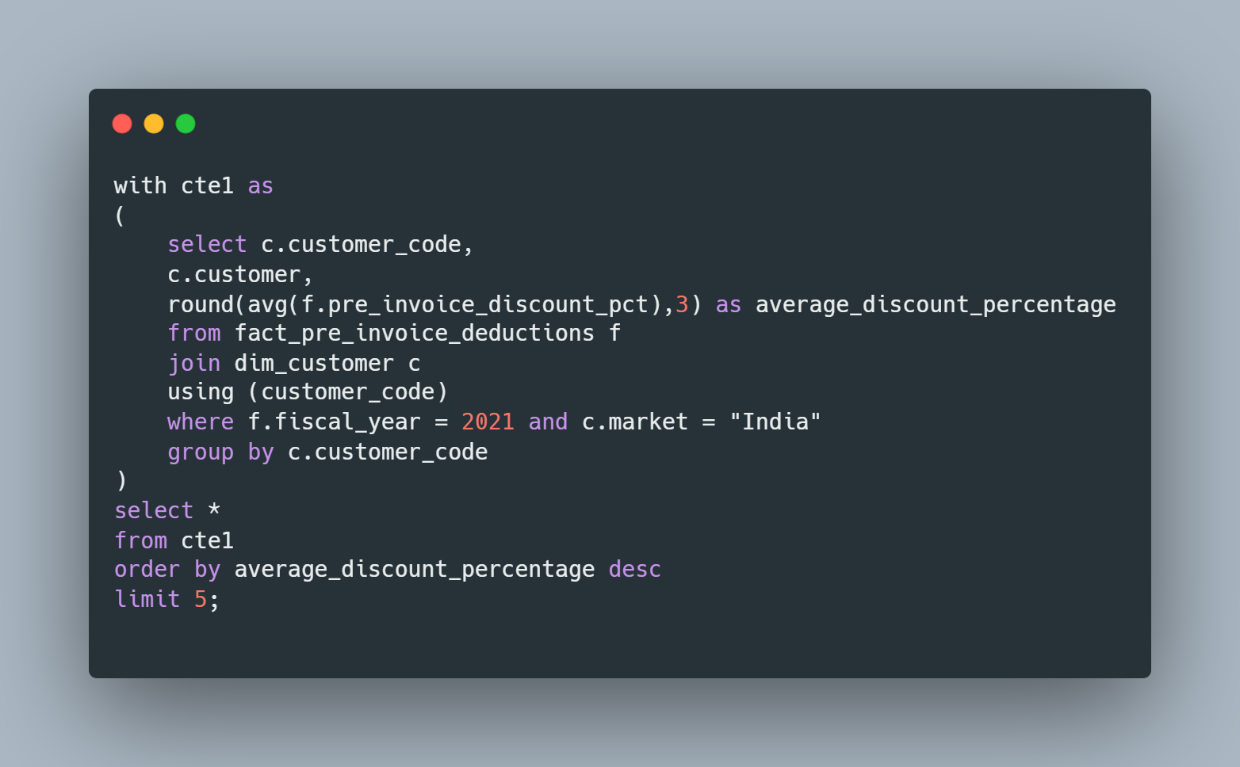
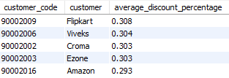
6. Generate a report which contains the top 5 customers who received an average high pre_invoice_discount_pct for the fiscal year 2021 and in the Indian market.
SQL Query and Results

Slide 17
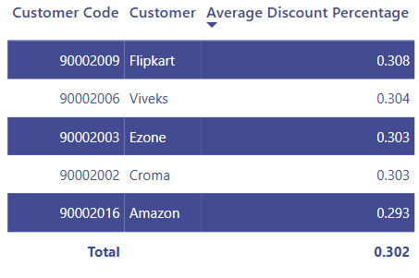
Visual Representation of sixth request

Slide 18
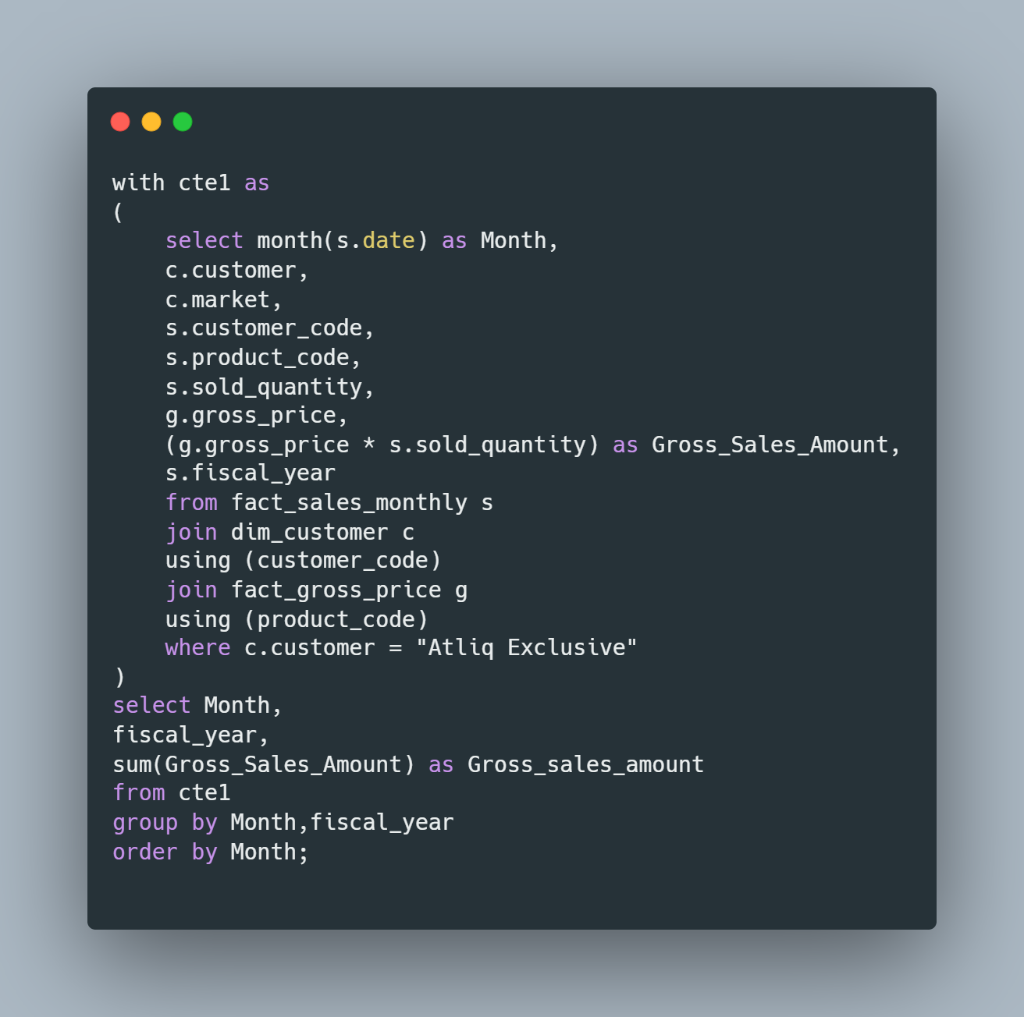
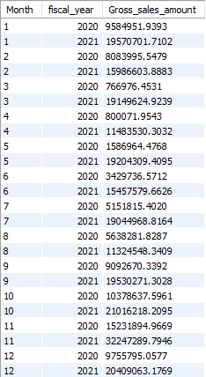
7. Get the complete report of the Gross sales amount for the customer “Atliq Exclusive” for each month . This analysis helps to get an idea of low and high-performing months and take strategic decisions.
SQL Query and Results

Slide 19
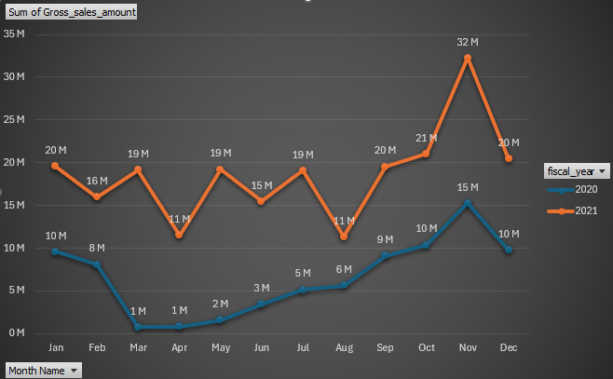
Visual Representation of seventh request

Slide 20
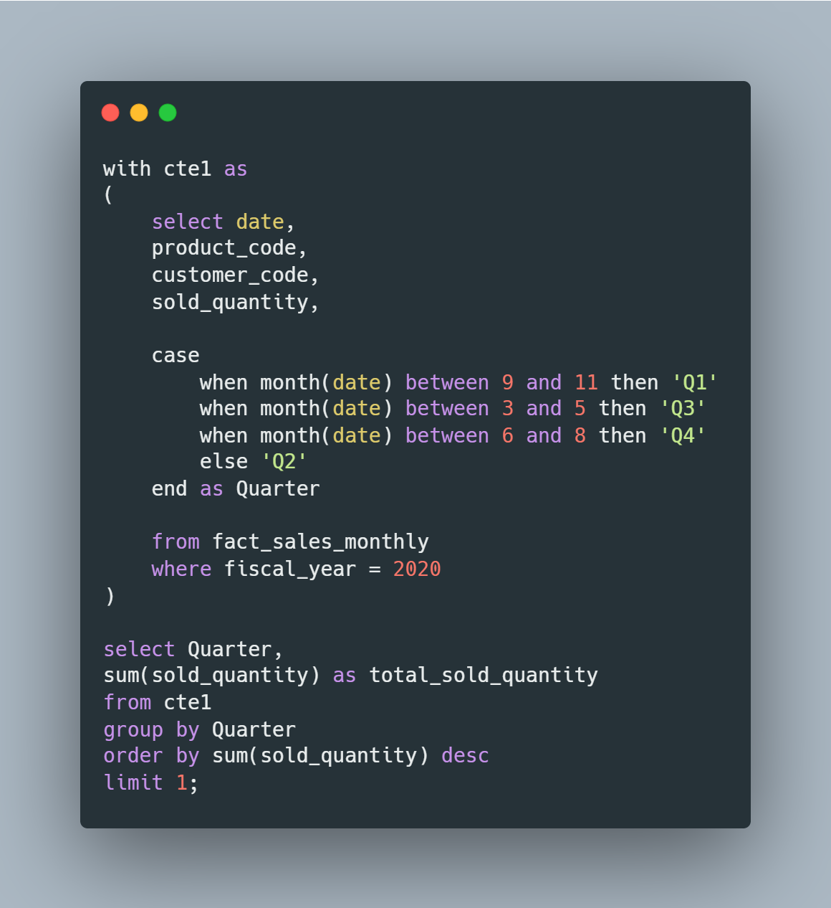

8. In which quarter of 2020, got the maximum total_sold_quantity?
SQL Query and Results

Slide 21
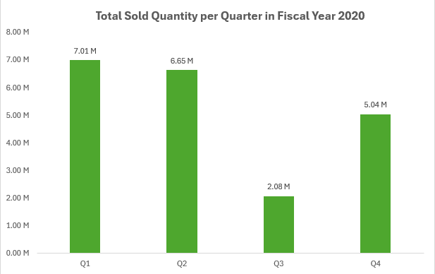
Visual Representation of eighth request

Slide 22
Additional Insights from previous visual
As we can see from the visual in the previous slide, the Quarter with Maximum Sold Quantity in Fiscal Year 2020 is Q1 with 7.01M units sold across the quarter.

Slide 23
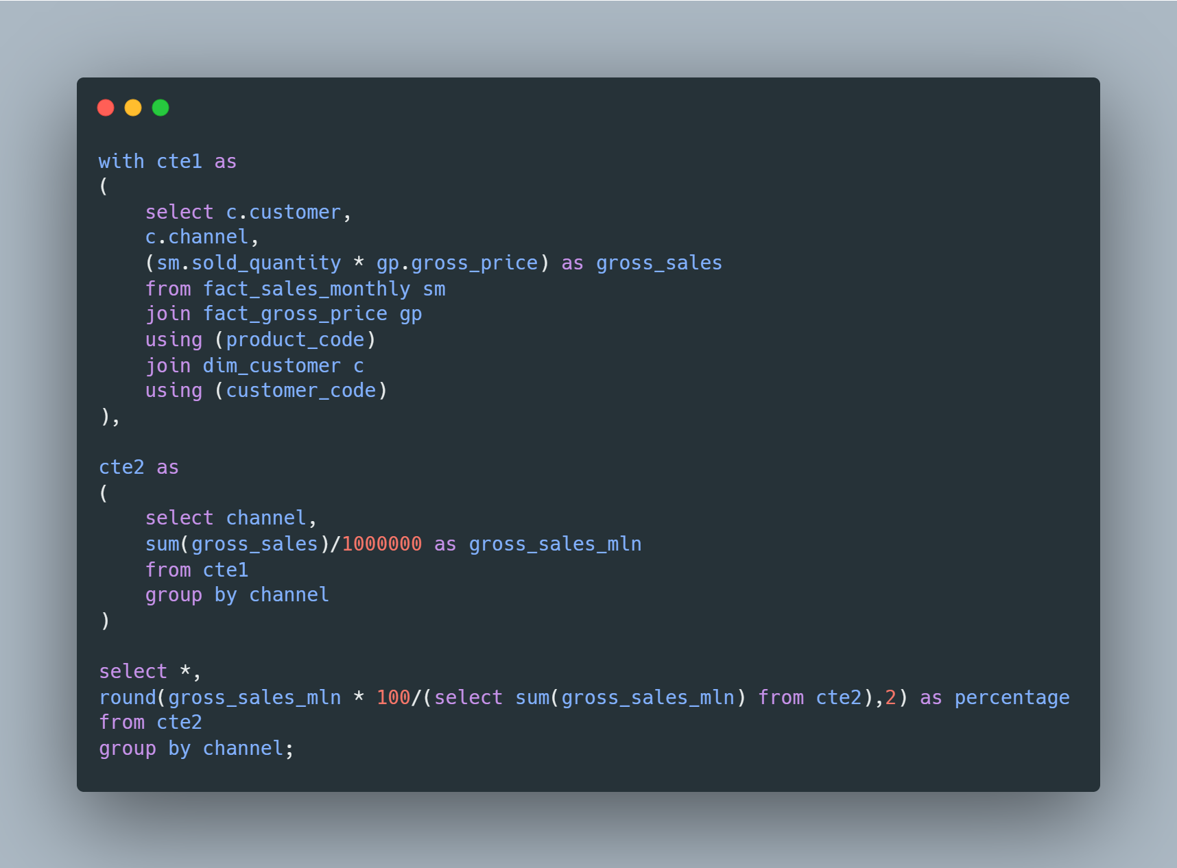

9. Which channel helped to bring more gross sales in the fiscal year 2021 and the percentage of contribution?
SQL Query and Results

Slide 24
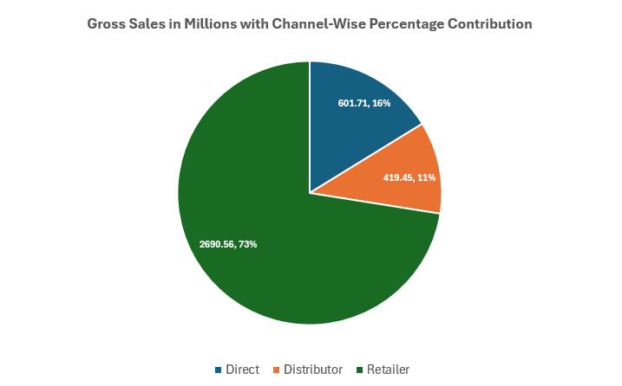
Visual Representation of ninth request

Slide 25
Additional Insights from previous visual
As we can see from the visual in the previous slide, the Retailer channel leads the Gross Sales charts in Fiscal Year 2021 with an amount equaling 2690.56M and accounting for approximately 73% of Gross Sales.

Slide 26
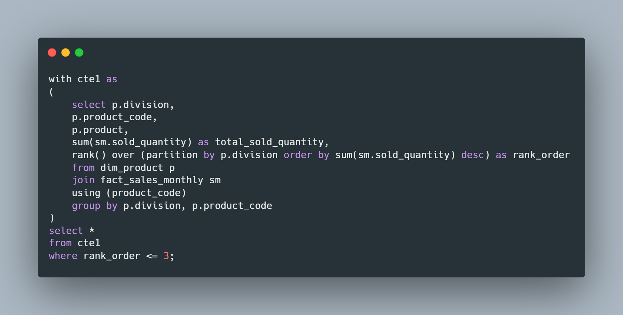
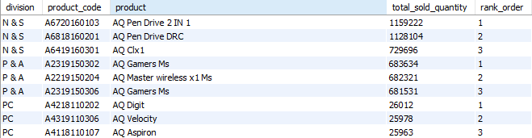
10. Get the Top 3 products in each division that have a high total_sold_quantity in the fiscal_year 2021
SQL Query and Results

Slide 27
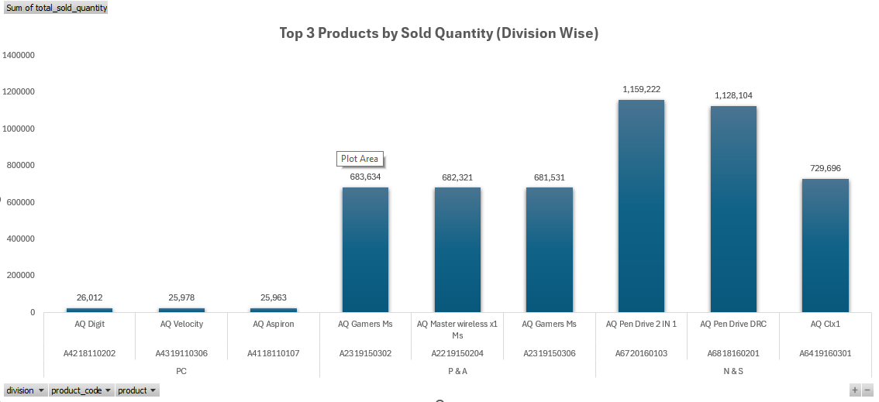
Visual Representation of tenth request

Slide 28

Thank you
Divyank Rawat
divyankrawat2021@gmail.com

